Slide 1
PCS 406
Professional Communication Skills

Slide 2
UNIT 2
Writing an Impressive CV

Slide 3
WEEK 4

Slide 4
Structuring your CV
You have researched yourself and identified your dream job
You have researched the market and found a vacancy
Now it is time to prepare a CV which will guarantee you an interview and maybe your dream job.
Job Hunting P. 19

Slide 5
Structuring your CV
What does CV stand for ?
What is a CV commonly called in American English ?
What is the main purpose of a CV?
What are the key qualities of a successful CV ?
What kind of sections are there in a CV?
Job Hunting P. 19

Slide 6
TARGET VOCABULARY

Slide 7
Personal Statement (n.phr.)
a brief statement of the type of person you are, your skills and your achievements

Slide 8
Expertise (n)
Skill or knowledge in a particular area

Slide 9
Result-focused (adj.)
Somebody who is practical and concentrates on results

Slide 10
Self-starter (adj.)
a person who is sufficiently motivated or ambitious to work on their own initiative without needing direction

Slide 11
Interpersonal (adj.)
between people; involving personal relationships

Slide 12
Collaborate (v)
to work together on an activity or project

Slide 13
Negotiate (v)
try to reach an agreement by discussion

Slide 14
Investigate (v)
To carry out research or study into a subject or problem etc.

Slide 15
Establish (v)
to start a company, organization, system, etc that is intended to exist or continue for a long time

Slide 16
Structuring your CV
Look at the sample CV in your Course Pack (p.6-7)and analyze each part of CV by answering questions.
What are the subparts of it?
What kind of information is given in each subpart?
How is it organised ?
On page 8 in your course pack there is a list of transferable skills that can be used while writing a CV. Look at them and do the activities 1b & 1c on page 8.
Course Pack P. 6-7-8

Slide 17
Avoiding common CV mistakes
In pairs, think of five mistakes that people commonly make when writing a CV.
Possible Mistakes
Sending the same CV for all jobs
Making spelling mistakes
Including irrelevant information
Providing too much information
Using a bad layout
Including lies
Job Hunting P. 22

Slide 18
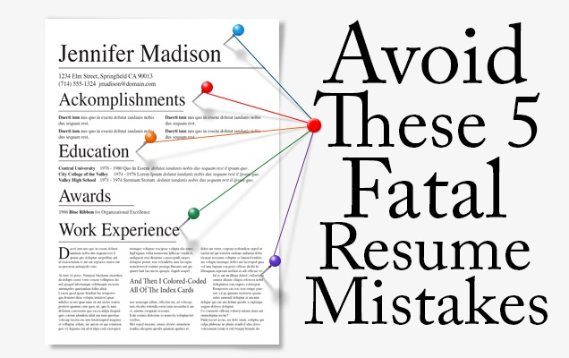
Avoiding common CV mistakes
Alex Mencken is a student who has recently decided to apply for two jobs in London.
Listen to his dialogues with his friend Ella and do the exercises 2 b, c, d, & e.
Job Hunting P. 22

Slide 19
WEEK 5

Slide 20
Creating a strong first impression
Writing a personal statement
A personal statement is a brief statement of the type of person you are, your skills and your achievements
It is at the top of CV and presents the facts in the most positive way
A well-written personal statement immediately capture the attention of the employer
Job-hunting P. 23

Slide 21
Creating a strong first impression
Read Silvia’s personal statement from her CV and do exercise 3a, b & c.
Look at the advertisement you have chosen in the first unit and make list of the key points the employer is looking for. Plan your personal statement and think about the questions in exercise 3f.
After doing exercise 3f, do exercise 3g.
Job Hunting P. 23&24

Slide 22
Creating a strong first impression
Now, it is your turn to write your own personal statement.
Look at your Course Pack (p. 8) and write a personal statement for your CV.
Do not forget to use expressions and ideas in exercise 3 in your course book.
Course Pack P. 8

Slide 23
WEEK 6

Slide 24
Highlighting your work experience
Now that you have written the first part of the CV, you will continue with the other parts.
Another section that you will write is «Experience» part of your CV.
In this part, you highlight your professional achievements which are directly relevant to the position you are applying for.
Course Pack
P. 8-9-10-11

Slide 25
Highlighting your work experience
In your Course Pack, do the exercises a & b on page 9.
While writing a CV some specific verbs which are commonly associated with professional experienc. These verbs are used in past simple and without personal pronoun. E.g. «Chaired weekly meetings»
Look at the sample CV and find the examples for this usage.
Course Pack P. 8-9-10-11

Slide 26
Highlighting your work experience
Now look at the table on page 9 in your course pack
Select five verbs from this table and write sentences for your CV that are true for you.
Course Pack P. 8-9-10-11

Slide 27
Highlighting your work experience
Listen to a discussion between Klaudia, who is looking for her second serious job and do the Exercise e in your Course Pack p.10 (Track 2.3 )
Now, it is your turn to write your own professional experience for your CV. Look at page 11 and fill in the chart in Exercise f.
After filling in the chart, write the experience section of your CV in Exercise g, p. 11.
Course Pack P. 8-9-10-11

Slide 28
Detailing your education & qualification
If your education & qualifications are your strongest selling points, then you should put it close to the top of your CV.
This is especially true if :
you are a recent graduate,
obtained excellent academic results,
have gained a professional qualification
Course Pack P. 12

Slide 29
Detailing your education & qualification
Discuss the following questions:
Where should you put the education section of your CV?
What qualifications should you include ?
Look at the education part of the sample CV in your course pack (p.6)
What kind of information is included in this part?
How is this information organized?
Course Pack P. 6

Slide 30
Detailing your education & qualification
Now it is your turn to write the education part of your CV.
First fill in the chart in your Course Pack (p.12) .
Then, think of the advertisement you chose before and write the education part of your CV in your Course Pack (p.12)
Course Pack
P. 12

Slide 31
WEEK 7

Slide 32
Demonstrating your interests
The things you like doing in your free time say a lot about you.
Your personality is relevant to every job application.
In pairs, discuss the following questions:
If you have produced a CV before, what did you put in the personal interest section?
What should you put in personal interest section?
Why do employers want to know about your interests?
Job-hunting
P. 30

Slide 33
Demonstrating your interests
Listen to two recruitment experts, Grace & Oliver, and do exercise 8b.
Do the exercises 8c & d by matching the skills and personal characteristics.
Sometimes it is more effective to present your interests in terms of who you are, instead of what you like doing.
Look at the chart on page 31 and do the exercises 8e & f
Job-hunting
P. 30-31

Slide 34
Demonstrating your interests
Now, it is your turn to write your personal interests in your CV.
Think of the job you have chosen and write the interest section of your CV in your Course Pack, (p.13).
Do not forget to use the phrases and adjectives in exercise 8 in your course book.
Course Pack
P. 13

Slide 35
Providing References
References provide further evidence to potential future employers that
you are who you say you are
you have done what you claim to have done for previous employers
It is highly likely that your referees will be contacted if you are shortlisted.
It is essential to select them carefully

Slide 36
Providing References
References provide confidential information about your character, skills and experience. A positive recommendation will greatly support your application.Here is a list of tips for writing references:
Write two people who know you well and who you worked with and who can assure you for the prospective employer
Try not to include your family member in your references
Give the job titles of the referees
Ask for permission of your referees
Write your references in the last part of your CV
Give accurate contact information of your referees

Slide 37
Providing References
Good & Bad Examples
Look at the two references and discuss what is the problem with the bad example.
1
2

