Slide 1
ÇANKAYA UNIVERSITY FOREIGN LANGUAGES UNIT
PCS 406 Professional Communication Skills

Slide 2
JOB-HUNTING Week 1 Course Introduction

Slide 3
ABOUT YOUR INSTRUCTOR
Name & Surname:
Office:
Office Phone Number:
E-mail:

Slide 4
Course Description
PCS 406 is a skill-based course focusing on the active and accurate use of English in a variety of post-graduate environments
The course aims:
to help students become acquainted with the procedures of job-hunting
to help them acquire the necessary language skills for high level professional performance on the job. To this end,
The course includes CV writing, the writing of cover letters, interview skills, as well as socializing, telephoning, and holding meetings.

Slide 5
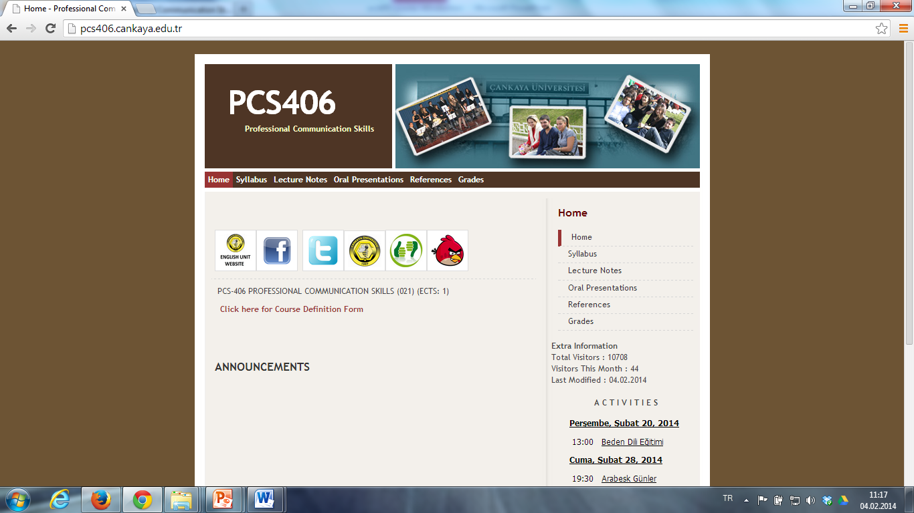
http://pcs406.cankaya.edu.tr/

Slide 6
Course Materials
1. COURSE BOOK
Where can you buy the course book ?
Dünya Aktüel Kitabevi
Aşağı Öveçler Mahallesi 1042. Cadde, 1330. Sokak, No: 3/1 Dikmen Çankaya ANKARA

Slide 7
Course Materials
2. COURSE PACK
In addition to your course book, you need to get a copy of course pack which you will use throughout the course.
You can get the copy from the photocopy man Ali Bey.
You need to bring both your course book and course pack in each lesson during the semester.

Slide 8
Attendance
Students are required to attend classes and examinations. Minimum required attendance is 80% for class sessions per semester, which makes up 6 hours of absence at most.
A student who does not fulfil the requirement for attendance is not allowed to take the final exam for the semester concerned and is to repeat the course.
Students who miss an exam will not be given a make-up exam unless they submit an approved medical report or any other official document proving their excuse.

Slide 9
Grading
Midterm: 30%
In-class Writing: 15%
In-class Oral Performance: 10%
Teacher Assessment: 5%
Final: 40 %

Slide 10
In-class Writing & Oral Performance
In-Class Writing (15 pts.):
CV & Cover Letter
7 tasks in total
Only in-class writing
No portfolio
In-class Oral Performance (10 pts.):
Discussions, Question Answer Sessions
Interview Activities

Slide 12
Let’s Start

Slide 13
JOB-HUNTING Unit 1 Research & Preparation

Slide 14
Identifying the stages in the job application process
Most of us spend 60-80 % of our waking hours working.
It is important to find a job that brings satisfaction
Finding a good job requires time and effort.
This long and challenging process has some stages.
What are the stages of job application process ?

Slide 15
Target Vocabulary

Slide 16
First-hand experience (adj. Phr.):
* if you experience something first hand, you experience it yourself

Slide 17
Cover Letter (n):
*A letter sent with other documents to explain more fully or provide more information

Slide 18
CV (Curriculum Vitae )(n)
A document to show one’s background and skills to secure new employment

Slide 19
Resumé (n)
* a short document describing your education, work history, etc., that you give an employer when you are applying for a job

Slide 20
Follow-up letter (n.phr. )
*A follow-up letter is a document that applicants send to employers to make sure the company has received the applicant’s résumé and cover letter or application

Slide 21
Professional (n)
someone who works in a job that needs special education and training, such as a doctor, lawyer, or architect

Slide 22
First degree (n)
used to talk about a university degree such as a BA or a BSc, obtained by people who do not already have a degree

Slide 23
Graduate
(n) someone who has completed a university degree, especially a first degree
(v) to obtain a degree, especially a first degree, from a college or university

Slide 24
Identifying the stages in the job application process
Teresa Fernandez, a recent graduate, is applying for a job in marketing.
Match the extracts from documents and conversations to the stages in the job application.
Do the exercises 1b, c, & d.

