Slide 1
PCS 406
Professional Communication Skills

Slide 2
UNIT 5
Advanced Interview
Techniques

Slide 3
WEEK 13

Slide 4
Demonstrating Your Skills
In interviews, it is important to provide evidence of how you acted in real situations in the past.
It will help you to show you have the transferable skills required for the job you are applying for.
Job-hunting
P. 60

Slide 5
TARGET VOCABULARY

Slide 6
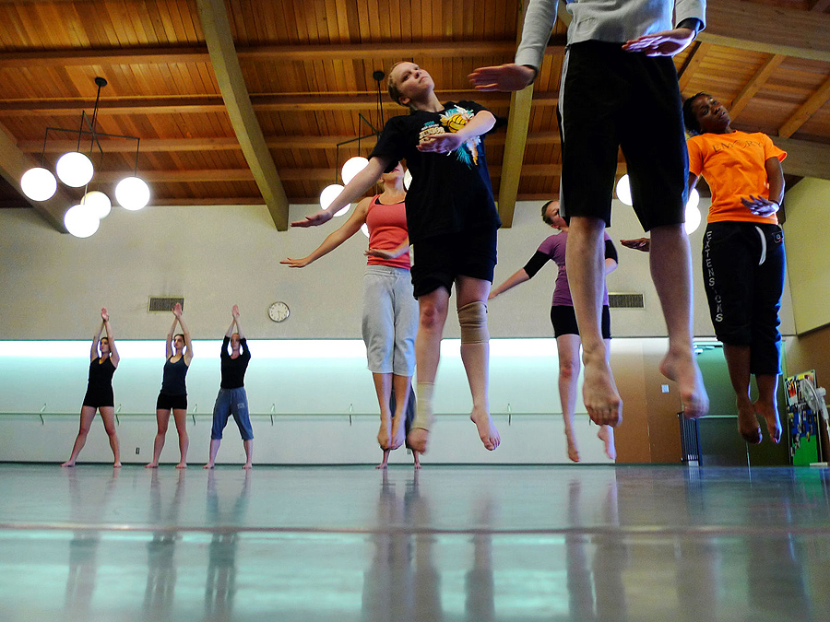
Rehearse (v)
to prepare in your mind or practise privately what you are going to do or say to somebody

Slide 7
Posture (n)
the position in which you hold your body when standing or sitting

Slide 8
Explicit (adj)
clear and easy to understand

Slide 9
Concise (adj)
giving only the information that is necessary and important, using few words

Slide 10
Tackle (v)
to make a determined effort to deal with a difficult problem or situation

Slide 11
Eye-catching (adj.)
immediately noticeable because it is particularly interesting, bright or attractive

Slide 12
Outstanding (adj.)
extremely good; excellent

Slide 13
Fulfilling (adj.)
causing somebody to feel satisfied and useful

Slide 14
Demonstrating Your Skills
After applying for a variety of positions at pharmaceutical companies, Vicky Tand is invited to attend an interview at Clyde & Johnson’s.
Listen to extracts and do the exercises 2a, b, c,d & e.
Job-hunting
P. 60-61

Slide 15
Demonstrating Your Skills
Vicky uses the STAR method to structure her answers in the interviews.
STAR method means:
Situation (the problem the company is facing)
Target (the solution to this problem)
Action (What the interviewee did to solve the problem)
Result (the results of the interviewee’s actions)

Slide 16
Demonstrating Your Skills
Look at Vicky’s response in exercise 2g and underline the phrases that describe the four sections.
Please do the exercises 2 h, i, j, n & o.
Job-hunting
P. 61

Slide 17
WEEK 14

Slide 18
Talking About Weaknesses
Turning negatives into positives:
In interviews, you will certainly face challenging questions which attempt to assess your suitability for the job.
It is vital to avoid getting caught in the trap of saying negative things about yourself.
Preparing for these «difficult» questions will help you keep your answers positive.

Slide 19
TARGET VOCABULARY

Slide 20
Cope With(phr.v.)
to deal successfully with a difficult situation:

Slide 21
Delegate (v)
to give part of your work, power or authority to somebody in a lower position than you

Slide 22
End up (phr.v.)
to find yourself in a place or situation that you did not intend or expect to be in

Slide 23
Flaw (n)
a mistake in something that means that it is not correct or does not work correctly

Slide 24
Overcome (v)
to succeed in dealing with or controlling a problem that has been preventing you from achieving something

Slide 25
Put off (phr.v.)
to decide or arrange to delay an event or activity until a later time or date

Slide 26
Strict (adj)
Sth that must be obeyed exactly

Slide 27
Talking About Weaknesses
Jarek ,a recent graduate , has been invited for an interview with an international financial company.
Listen to his conversation with his friend, Olivia, and do the exercises 3 a, b, c, e.

Slide 28
Talking About Weaknesses
Tips for talking about weaknesses:
In response to open questions you should never actively volunteer negative information during an interview
Employers like to ask you to give negative information not to embarrass you, but to see what sort of a person you are
You will seem much more employable if you can show yourself as someone who sees problems as opportunities
Questions about weaknesses are actually a chance to demonstrate how you tackle and overcome problems, and why you are the right person for the job.

Slide 29
Talking About Weaknesses
Softening and Emphasis
When answering interview questions that require negative information you should soften any negatives in your response and emphasise any positive information.
Please do the exercises on pages 64,65 & 66.

